Slide 1
Time Series Analysis and
Forecasting Temperature of
Next Year
Presented by :-
Rudra Pratap Padhi – 170301140014
Subhrajeet Nayak – 170301140007
Abinash Barik – 170301151025
Sagar Kumar Majhi – 170301150007

Slide 2
ABSTRACT
Time series modeling and forecasting has fundamental importance to various practical domains. Thus a lot of active research works is going on in this subject during several years. Many important models have been proposed in literature for improving the accuracy and efficiency of time series modeling and forecasting.
Time series analysis comprises methods for analyzing time series data in order to extract meaningful statistics and other characteristics of the data. Time series forecasting is the use of a model to predict future values based on previously observed values.
To have authenticity as well as clarity in our discussion about time series modeling and forecasting, we have taken the help of various published research works from reputed journals and some standard books.

Slide 3
Requirements
Jupiter Notebook
Libraries according to uses
A csv file containing the data.
Machine learning Model (ARIMA).

Slide 4
TIMELINE
Duration | Topics learned & Project Progress
1st -April-2020 | Collection of Proper Temperature Data set of 2019 Python For Data Analysis
15th -April-2020 | All learning about Python Modules required for Data cleaning & representation
5th -May-2020 | Data Cleaning by Pandas. Using of Matplotlib Data Visualisation .
12th -June-2020 | Sarimax & AIC model Basic Use. Analyze Statically visualization model use statsmodels.api.
30th -June-2020 | Forecasting of Minimum and Maximum temperature of each month of 2020 Visual Analysis representation of predicted Data of 2020
2nd -July-2020 | Project is completely checked PPT is ready to be presented

Slide 5
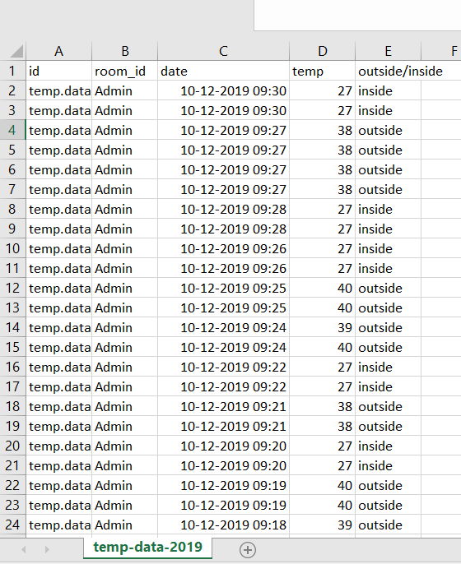
DATA COLLECTED OF YEAR 2019

Slide 6
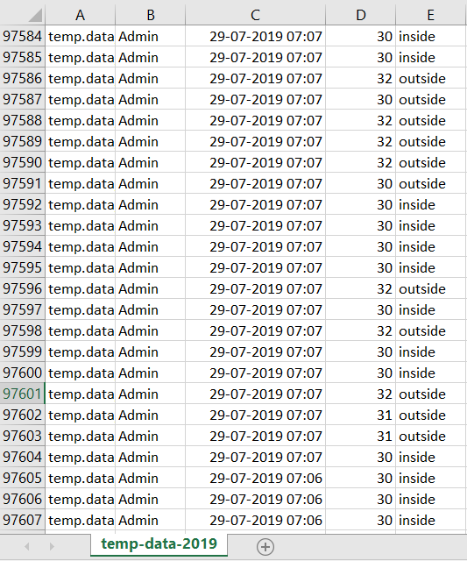

Slide 7
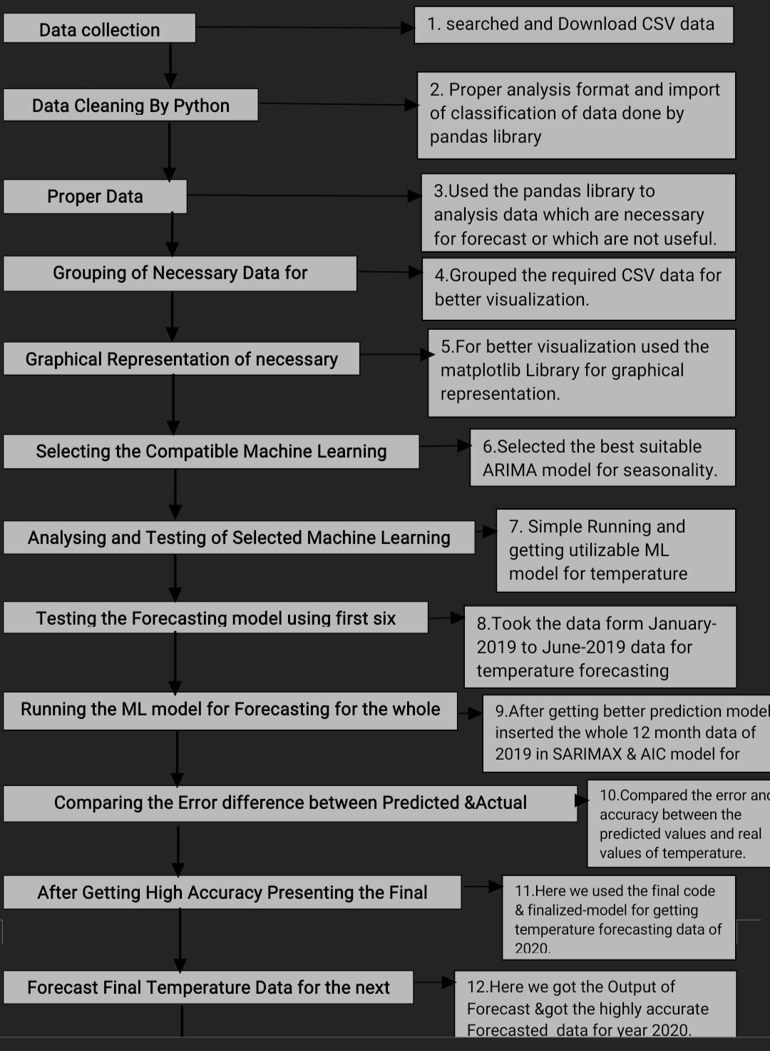
Flowchart

Slide 8
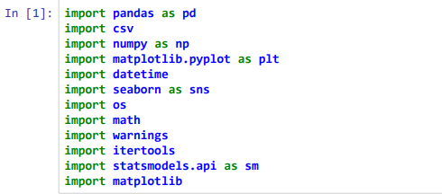
All learning about Python Modules required for Data cleaning
& representation
These are the libraries we used for different purposes.
For e.g.
  Grapical representation
  Calculation
  Reading the type of file it is.

Slide 9
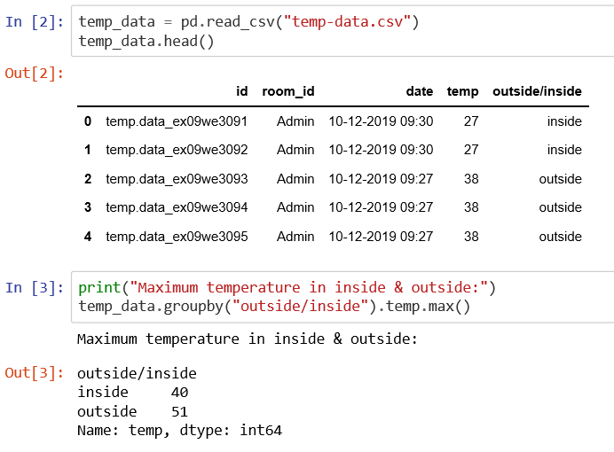
Python use & Data Cleaning by Pandas
Read the csv file used.
And tested whether the max and min temp is being read or not.

Slide 10
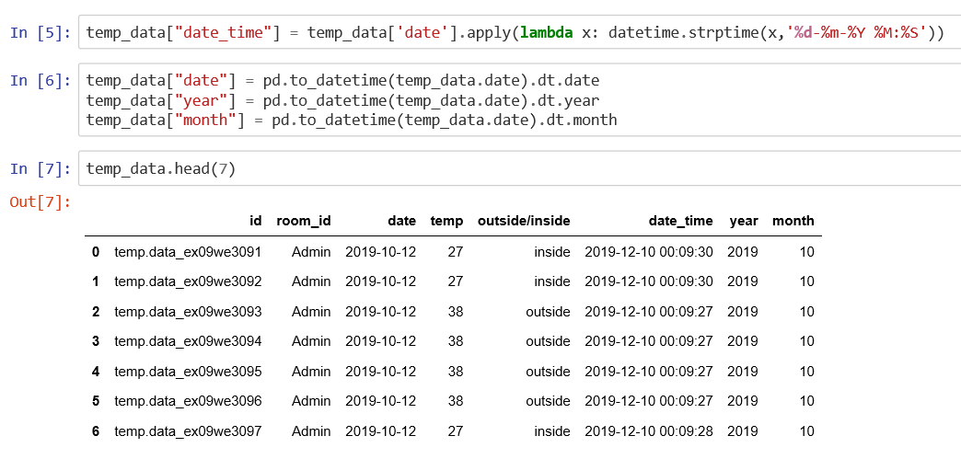
Preparation of a schedule based on few things :-
  Date
  Time
  Year
  Month
Date and time are an object in Python, so when you manipulate them, you are actually manipulating objects and not string or timestamps.

Slide 11
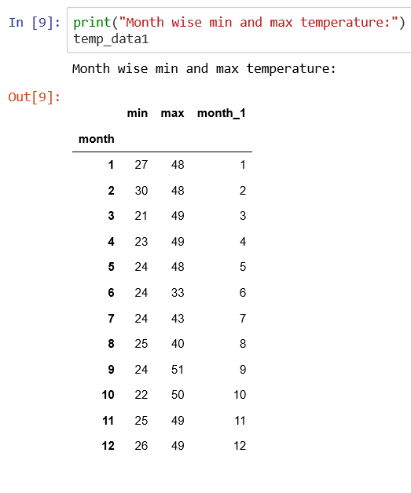
Maximum and minimum temp read on monthly basis

Slide 12
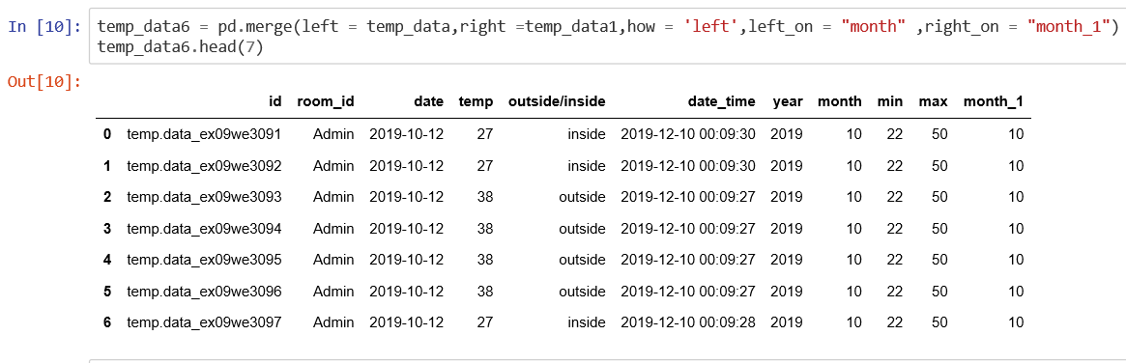
A complete representation in a single tabular format.
The represented format shows all the data present in the previous slides in a single table.

Slide 13
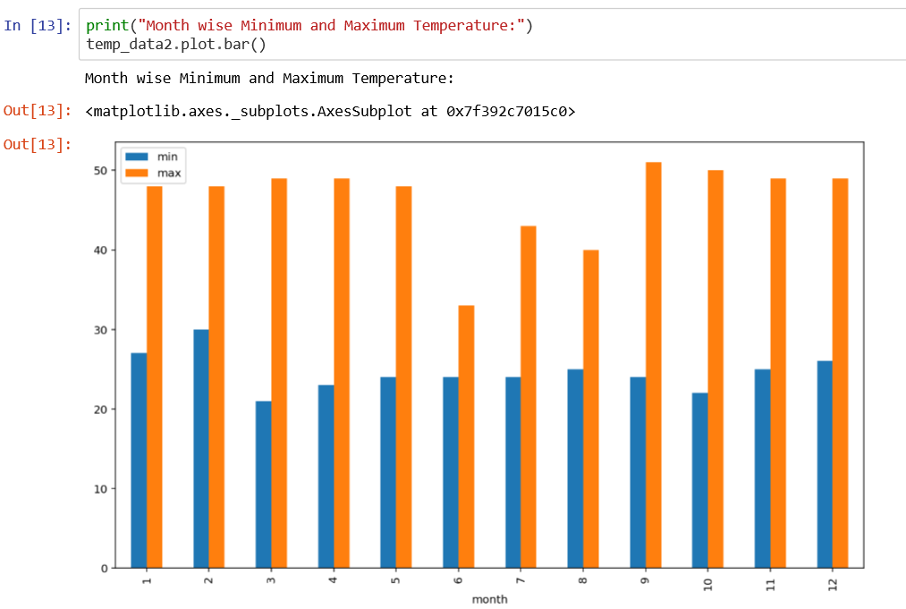
Using of Matplot library for
Data Visualisation

Slide 14
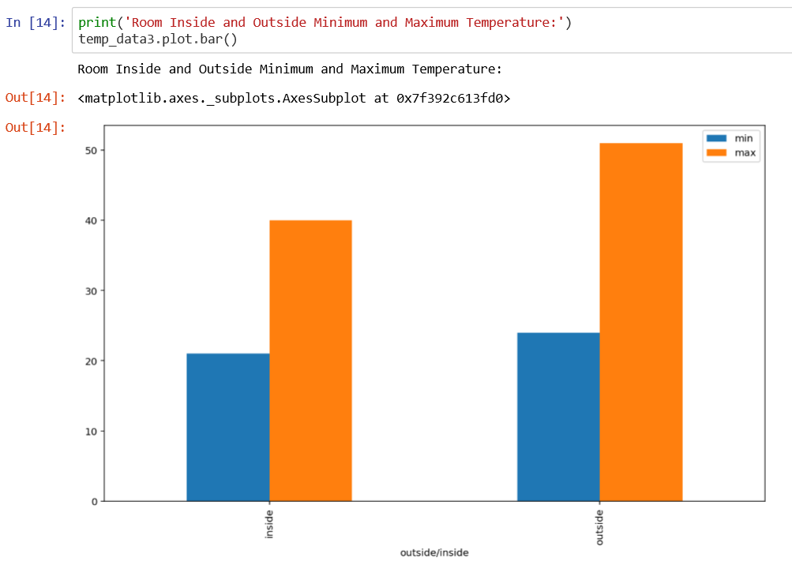
The representation of the room inside and outside maximum and minimum temperature

Slide 15
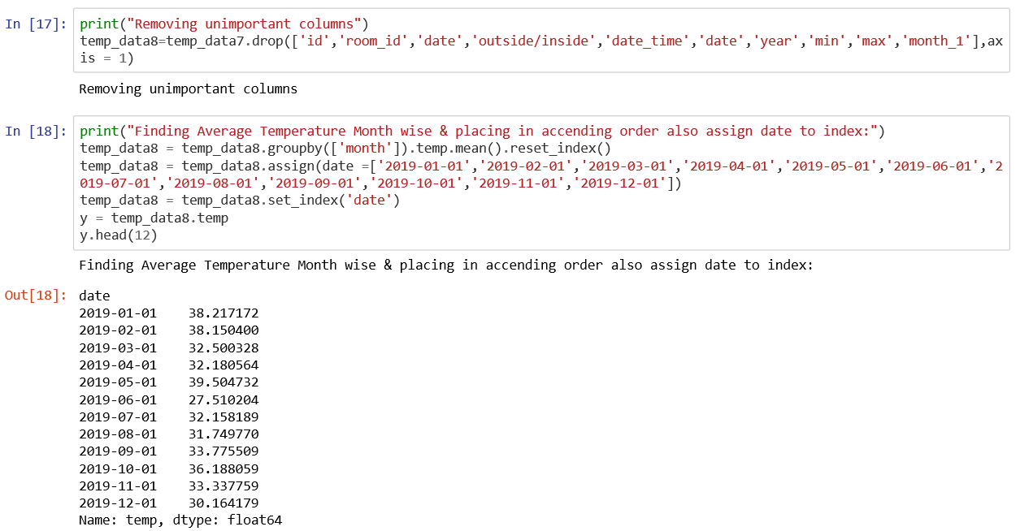
Finding Average Temperature of 2019 Month wise
The average temperatures are being calculated and placed in ascending order pf month.

Slide 16
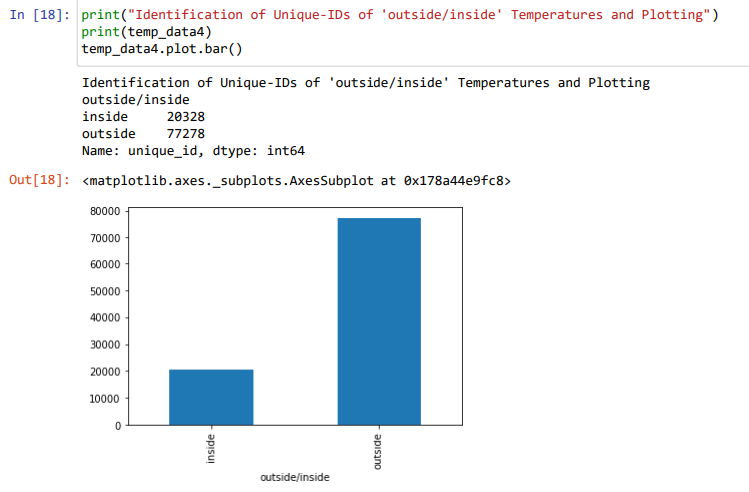
Identification of unique-id’s of ‘outside/inside’ Temperatures and plotting

Slide 17
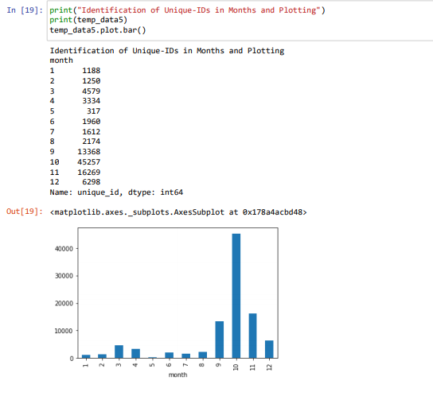
Identification of unique-id’s in months and plotting

Slide 18
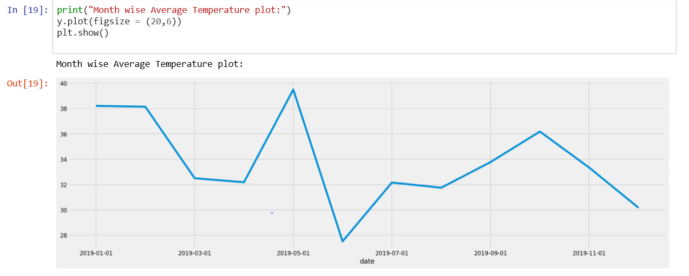
Month wise temperature is calculated and represented in plot

Slide 19
ARIMA
ARIMA is an acronym that stands for Auto Regressive Integrated Moving Average.
This is one of the easiest and effective machine learning algorithm to performing time series forecasting.
ARIMA is a statistical analysis model that uses time series data to either better understand the data set or to predict future trends.

Slide 20
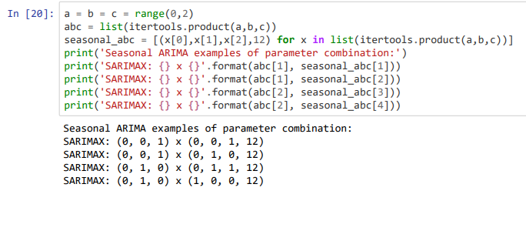
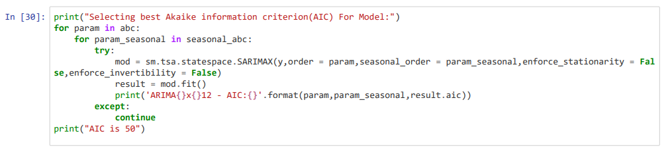
A model which helps in picking up less fluctuating values and less values for more accurate results

Slide 21
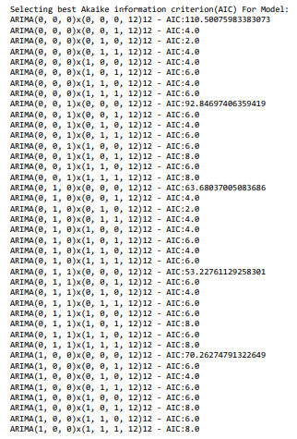
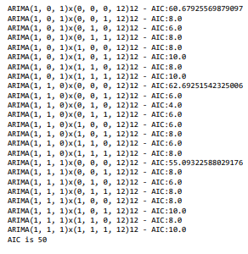
Output of the seasonal data
This data contain large number of fluctuating data which is further summarized.

Slide 22
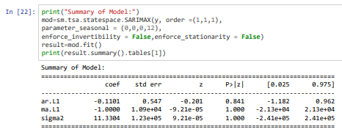
Summary of model
This shows all the AIC for model in small amount of values which can be used for prediction.
Because large amount of values will give a very high error or fluctuations.

Slide 23
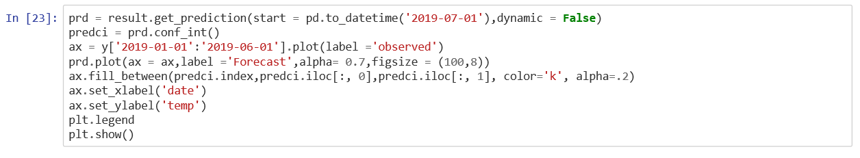
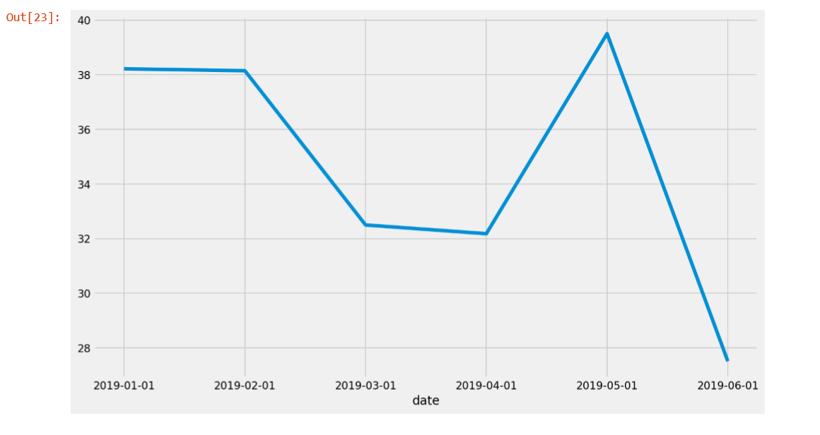
Prediction done for a particular period of time
The output seen is for the 6 month period.
It is being tested inside a model.

Slide 24
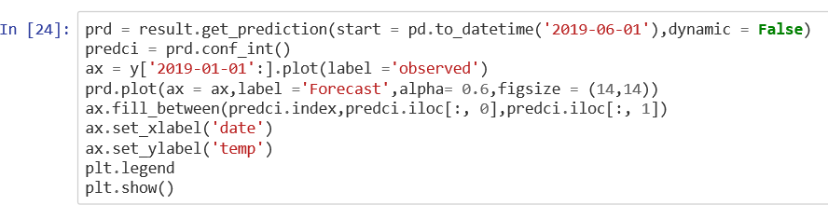
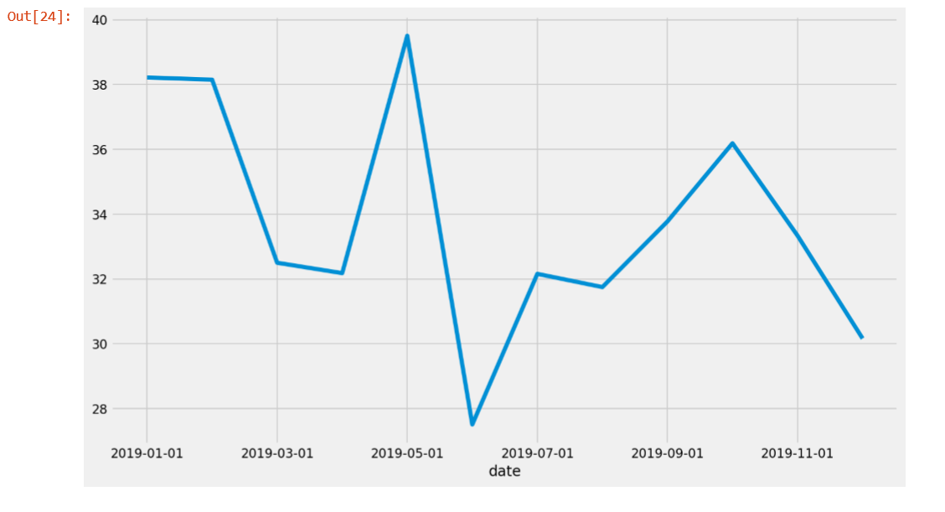
Total Prediction done for a year
Since the data of six month was successfully tested so the yearly values are predicted inside the model.
Each month’s average temperature is considered.

Slide 25
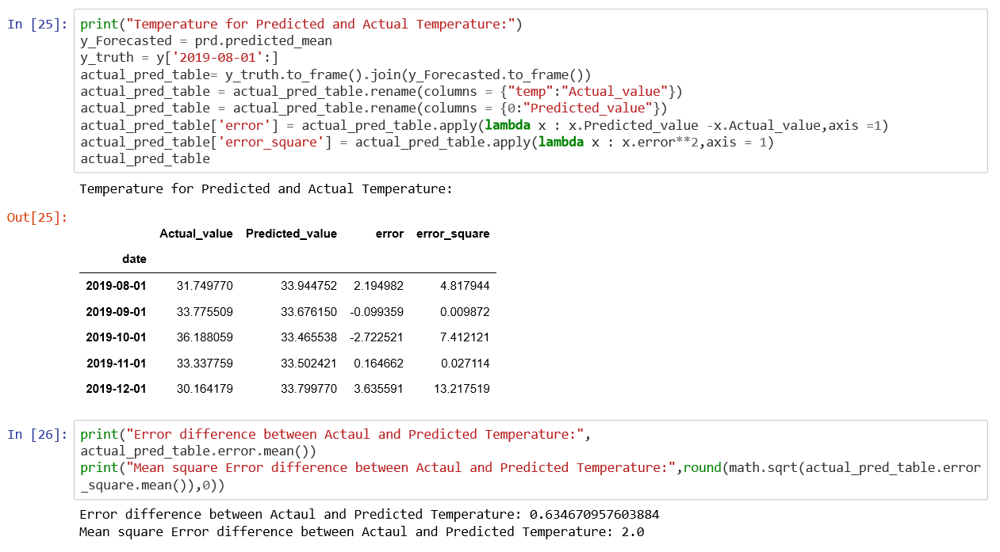
Error comparison between actual and predicted temperature
In this the actual temperature and predicted temperature are placed together.
Error is calculated.

Slide 26
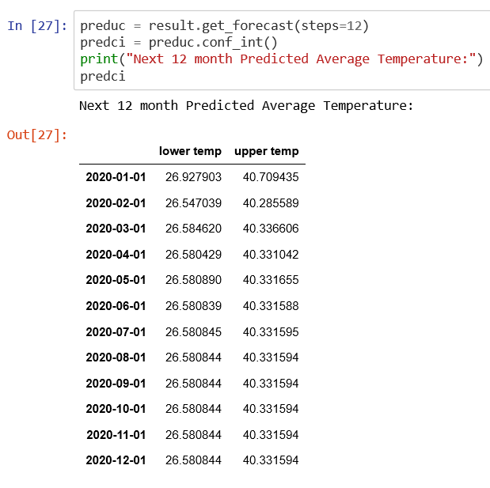
Forecasting of Minimum and Maximum temperature of each month of 2020

Slide 27
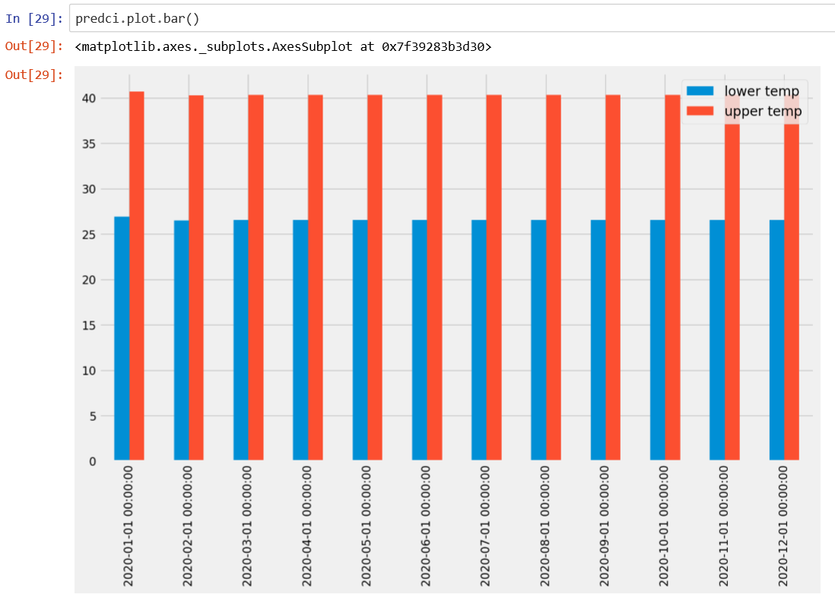
Visual Analysis representation of predicted Data of 2020
Every month’s lowest and highest temperature.

Slide 28
REFERENCES
Raicharoen, T., Lursinsap, C., & Sanguanbhokai, P. (2003). Application of critical support vector machine to time series prediction. International Symposium on Circuits and Systems (Vol.5, pp.V-741-V-744 vol.5). IEEE.
C. K. Lee, Y. Sehwan and J. Jongdae, "Neuralnetwork model versus SARIMA model in forecasting Korean stock price index (KOSPI)", Issues in Information System, vol. 8, no. 2, pp. 372-378, 2007.
M.J.C. Hu, "Application of ADALINE system to weather forecasting", Technical Report, 1964.
D.F. Cook and M.L. Wolfe, "A back propagation neural network to predict average air temperatures", AI Applications, vol. 5, pp. 40-46, 1991.
Chatfield, C. (1994): The Analysis of Time Series-An Introduction. Chapman and Hall.
Montgomery, D.C., and Lynwood A.J. (1996): Forecasting and Time Series Analysis, Mc. Graw-Hill

Slide 29
7. Saima, H., Jaafar, J., Belhaouari, S. and Jillani, T.A. (2011): ARIMA based Interval Type-2 Fuzzy Model for Forecasting. International Journal of Computer Applications, Vol. 28, No. 3, pp. 17-21.Saima, H., Jaafar, J., Belhaouari, S. and Jillani, T.A. (2011): ARIMA based Interval Type-2 Fuzzy Model for Forecasting. International Journal of Computer Applications, Vol. 28, No. 3, pp. 17-21.
8. Mahmudur Rahman, A.H.M. Saiful Islam ,Sahah Yaser Maqnoon Nadvi , Rashedur M Rahman (2013) : Comparative Study of ANFIS and ARIMA Model for weather forecasting in Dhaka” IEEE
9. G.E.P. Box, G. Jenkins (1970), “Time Series Analysis, Forecasting and Control”, Holden-Day, San Francisco, CA.
10. E. J. Hannan, "Regression for time series" in Time Series Analysis, New York: Wiley, 1963.
11. M.Tektas, “Weather Forecasting Using ANFIS and ARIMA (2010): A Case study of Istanbul,” Environment Research , Engineering and Management , vol. 1(51), pp.5-10.
12. A. Shahi, R. Atan, M. N. Sulaiman, "An Effective Fuzzy C-Mean and Type-2 Logic for Weather Forecasting,". Journal of Theoretical and Applied Information, vol. 5 (5), pp. 556-567, 2009.
13. Z. Wei and Z. Feng, “Overview of data-driven time series forecasting methods,” Journal of Shaanxi University of Science & Technology, vol. 28, no. 03, pp. 22–27, 2010.

Slide 30


